Slide 2



FLS
FPT Lecturer Scheduler
Topic Code: FA22SE62
Group Code: GFA22SE49

Slide 3

FLS
THE SYSTEM GENERATES SCHEDULE FOR LECTURERS IN FPT UNIVERSITY
Mentor: Mr. Lam Huu Khanh Phuong
Members
Vu Minh Dang (Leader)
Tran Tuan Minh
Hong Dai Duong
Do The Duong
Nguyen Quoc Bao

Slide 4





agenda
01
05
03
02
04
INTRODUCTION
System features
Conclusion
Background
Problems
System design
Actors
System Features
Core Flow
Demostration
Limitations & Futures
Overall Architecture
Technologies
Assumptions
Demo
Solution & Algorithm

Slide 5

01
INTRODUCTION
Background
Problems

Slide 6
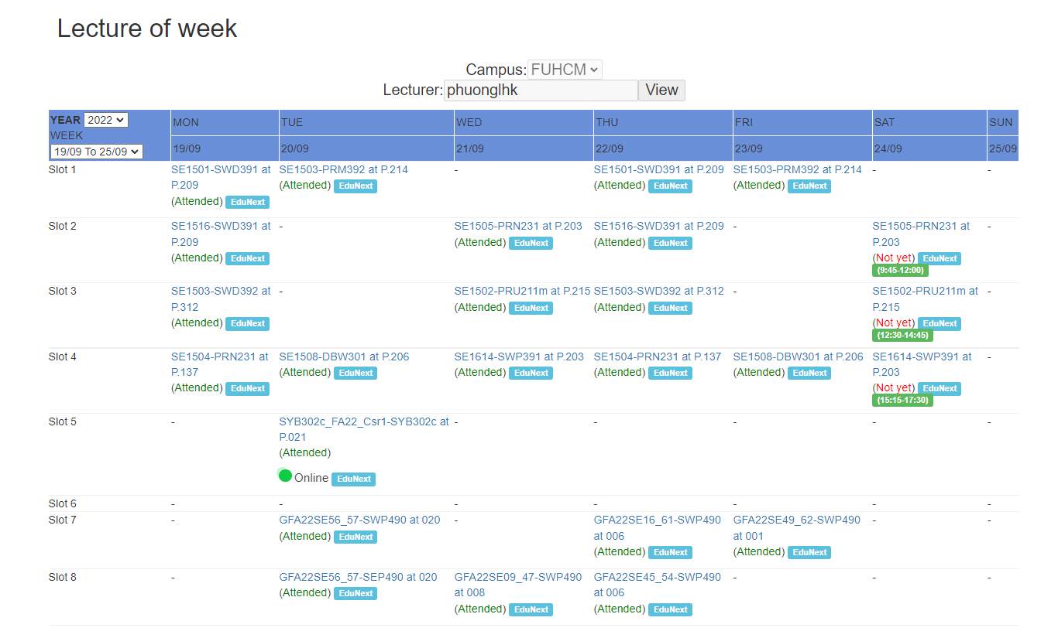
Background
Currently, the scheduling of lecturers at FPT University is being done manually, which is time consuming.

Slide 7



PROBLEMS
Wasting time
Favorite Subjects
Not optimized

Slide 8

02
System design
Overall Architecture
Technologies

Slide 9





OVERALl ARCHITECTURE
Winforms app
Web app
Back-end server
Mobile app
Database

Slide 10




technologies
Winforms app
Web app
Back-end server
Mobile app
Database

Slide 11

03
System features
Actors
Core Flow
System Features

Slide 12


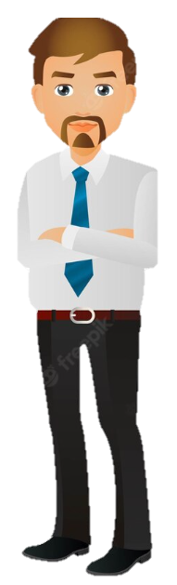
actors
Admin
Department Manager
Lecturer

Slide 13
CORE FLOW
Admin
Lecturer
Department Manager
Admin
Department Manager
Admin
New
Voting
Evaluating
Blocked
Adjusting
Public

Slide 14
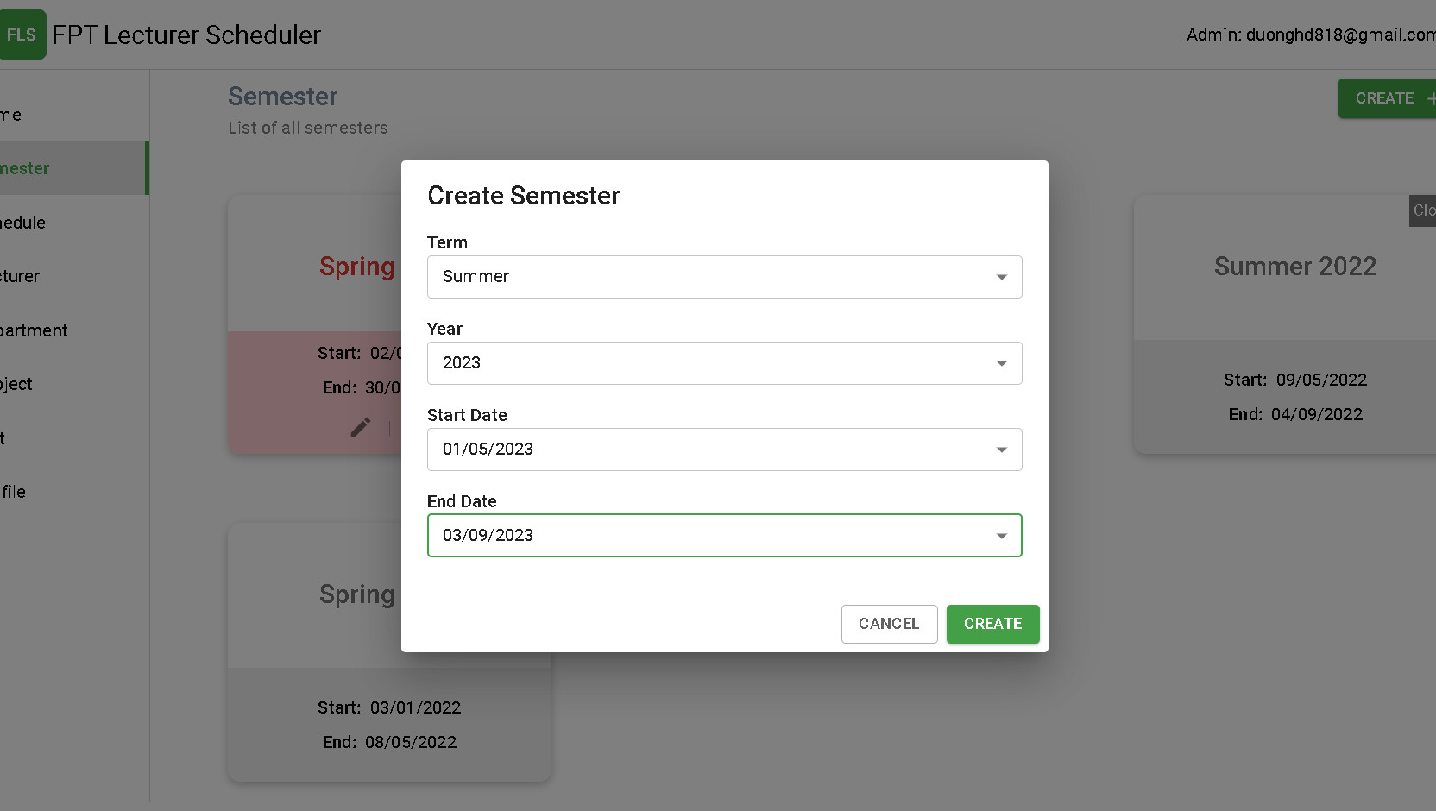
Admin
Admin create semester
Admin import coures
Admin change state semester
Admin generate schedule

Slide 15
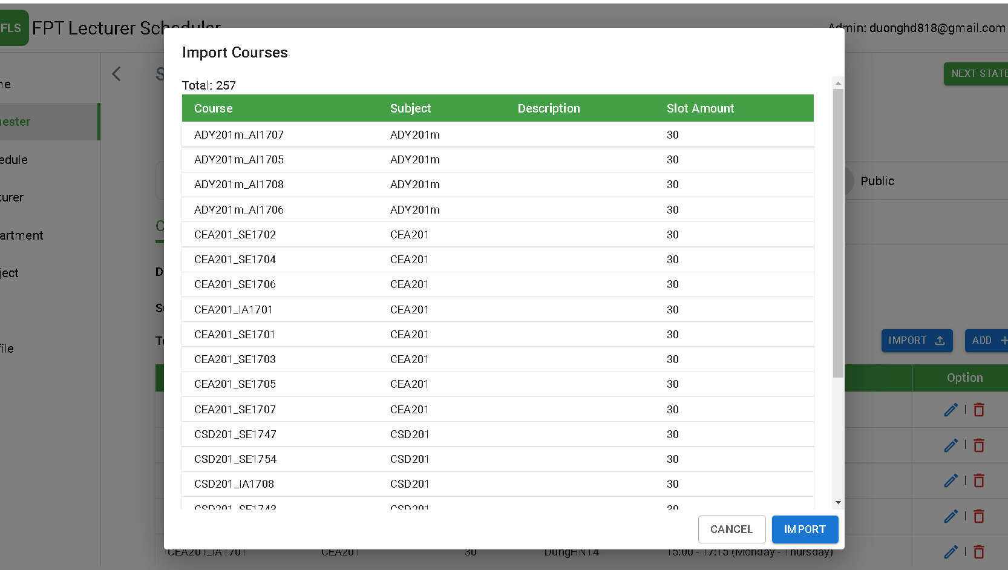
Admin
Admin create semester
Admin import coures
Admin change state semester
Admin generate schedule

Slide 16
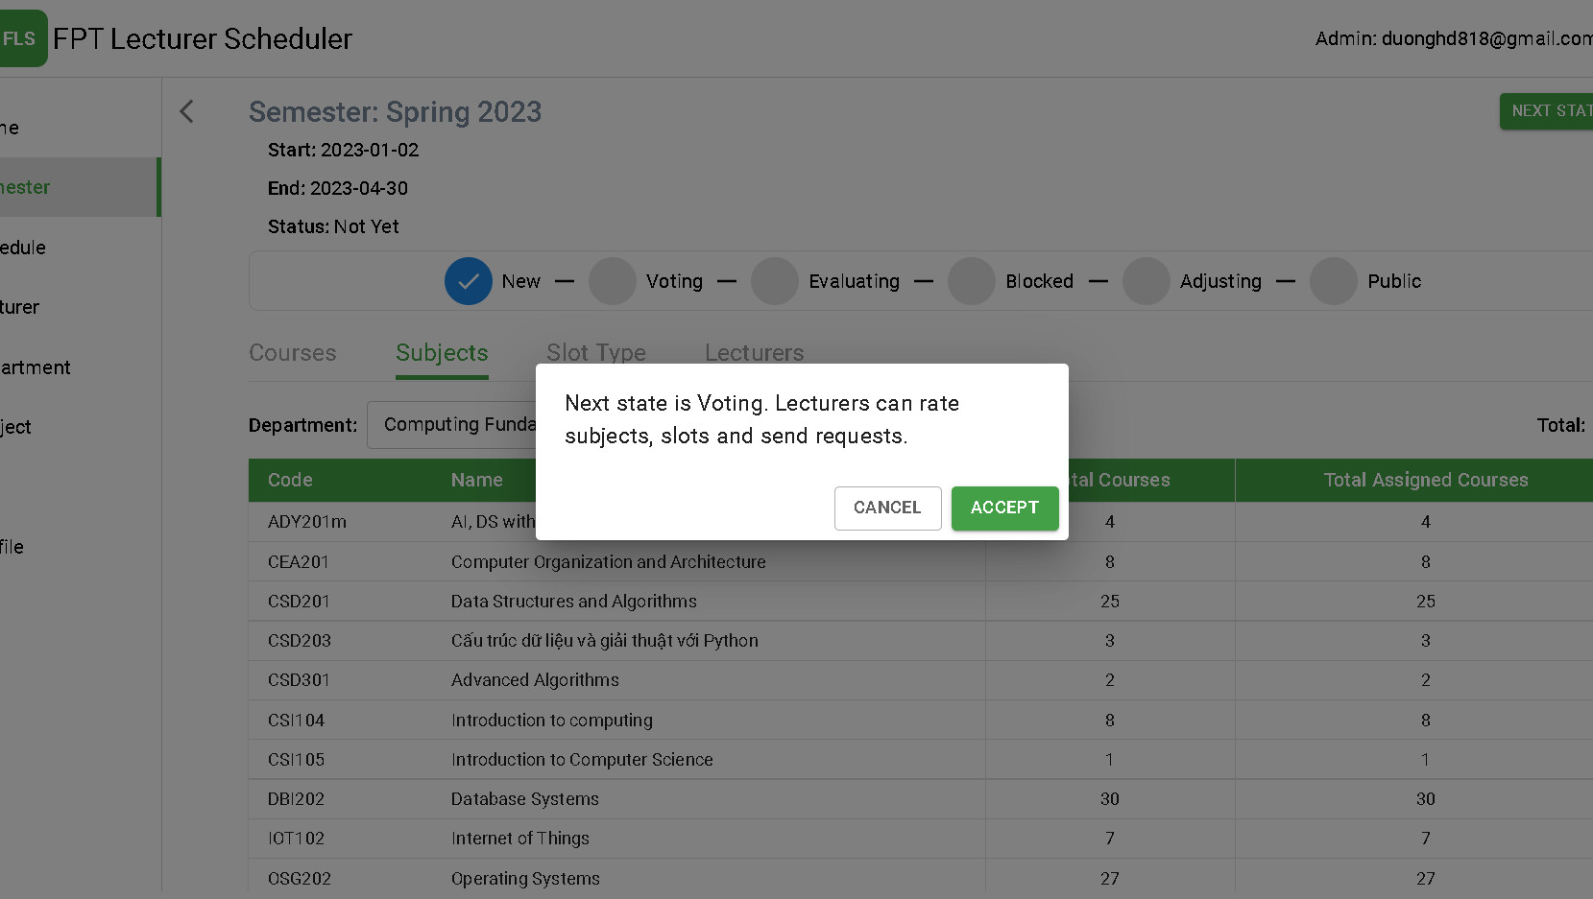
Admin
Admin create semester
Admin import coures
Admin change state semester
Admin generate schedule

Slide 17
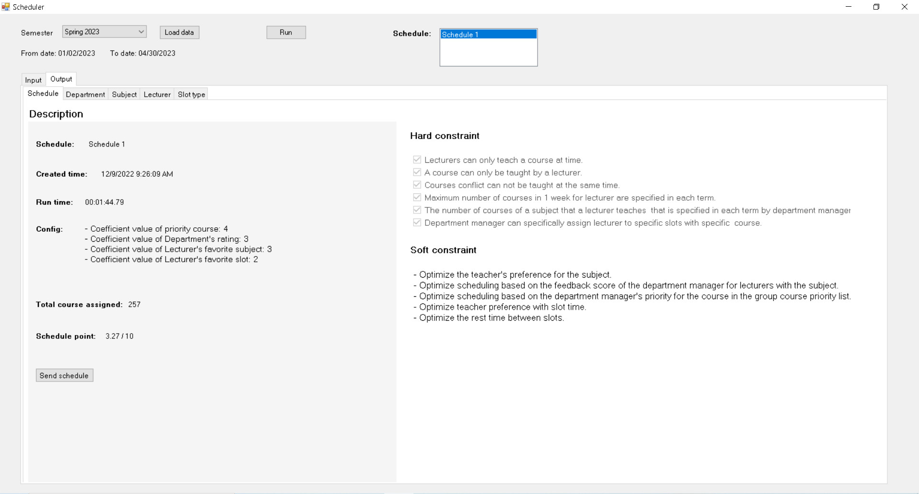
Admin
Admin create semester
Admin import coures
Admin change state semester
Admin generate schedule

Slide 18
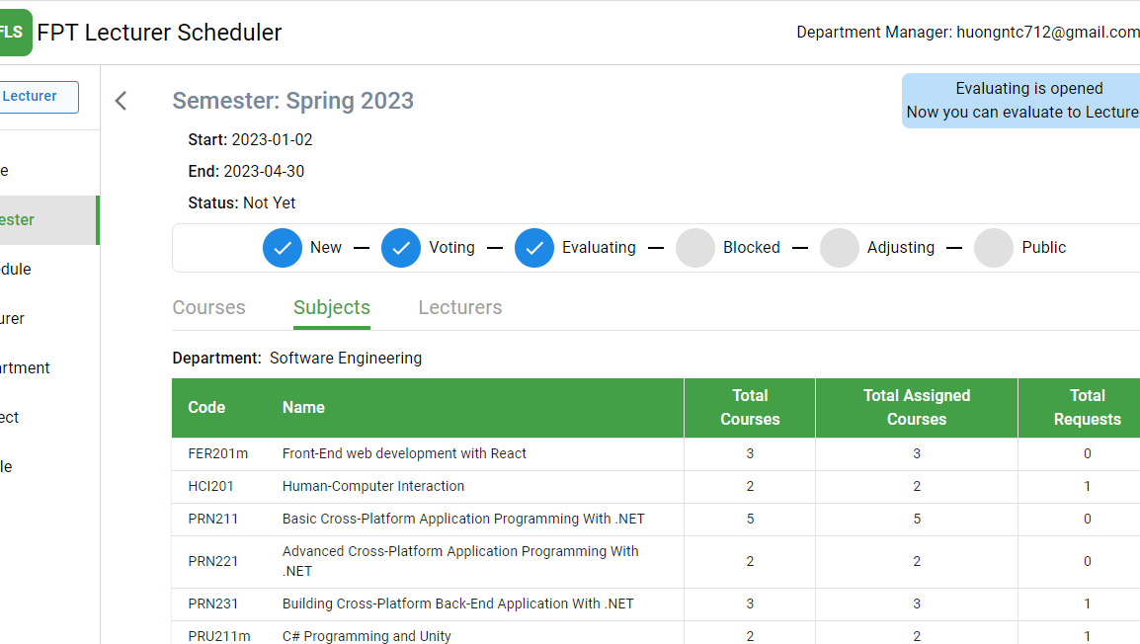
Department manager
Manage requests
Assign Courses
Evaluate Subjects
Prefer Slots

Slide 19
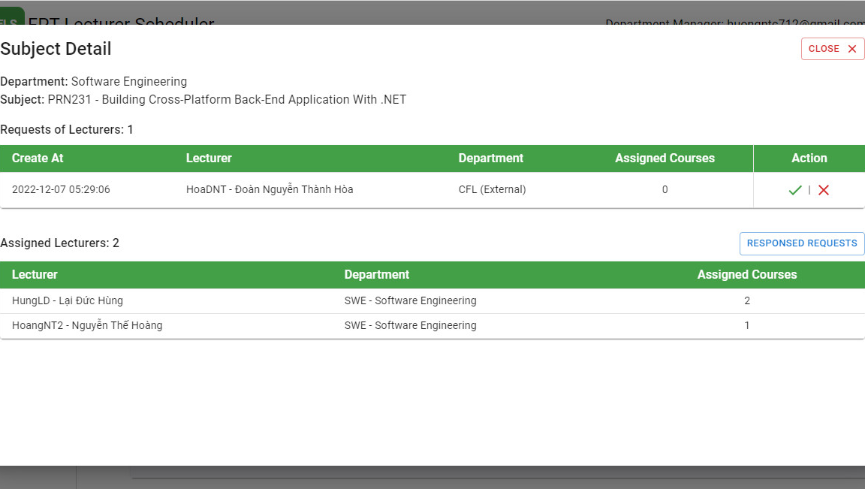
Department manager
Manage requests
Assign Courses
Evaluate Subjects
Prefer Slots

Slide 20
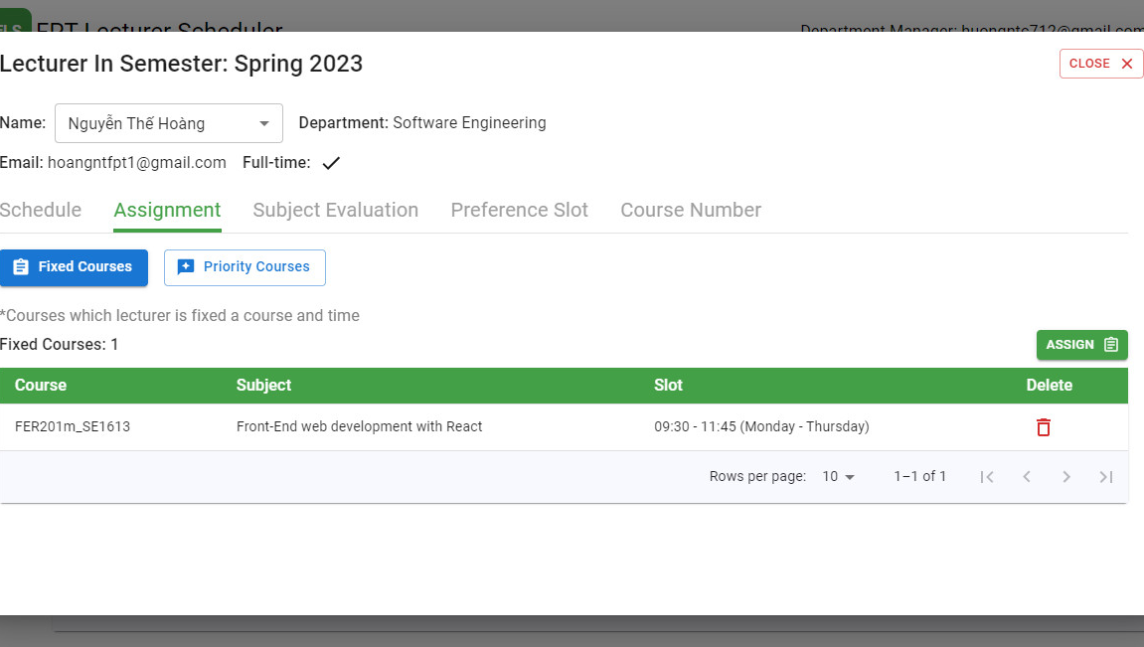
Department manager
Manage requests
Assign Courses
Evaluate Subjects
Prefer Slots

Slide 21
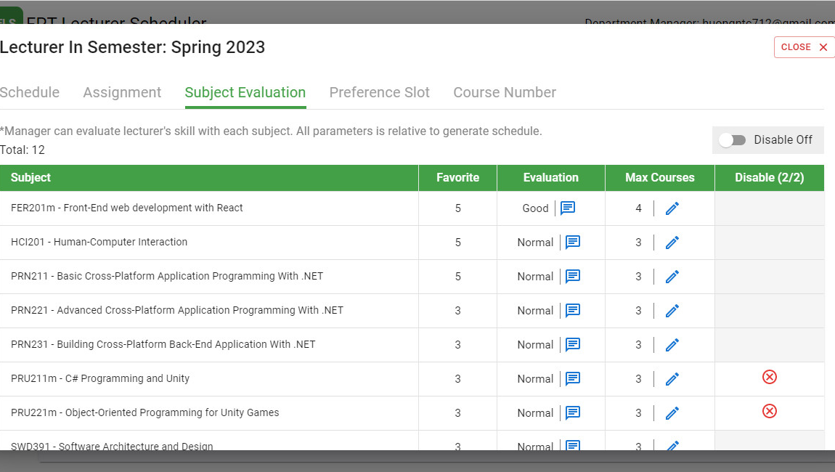
Department manager
Manage requests
Assign Courses
Evaluate Subjects
Prefer Slots

Slide 22
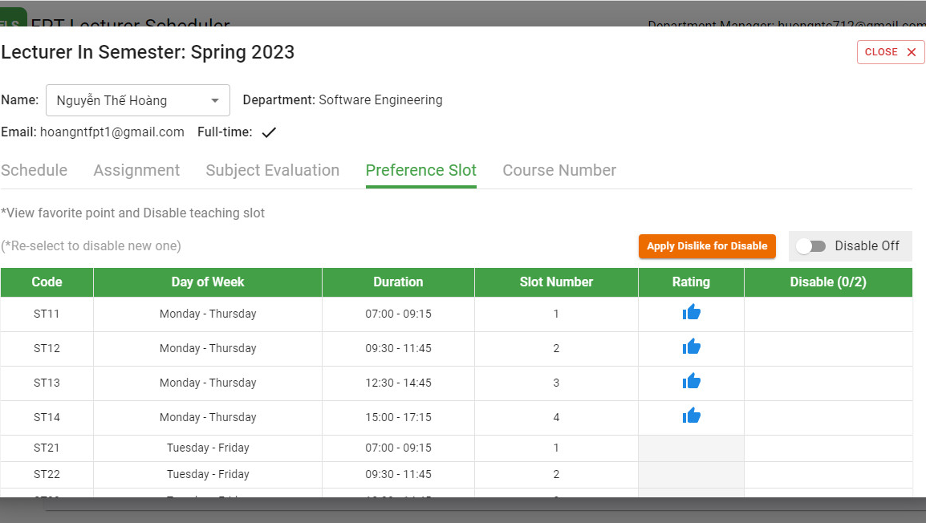
Department manager
Manage requests
Assign Courses
Evaluate Subjects
Prefer Slots

Slide 23
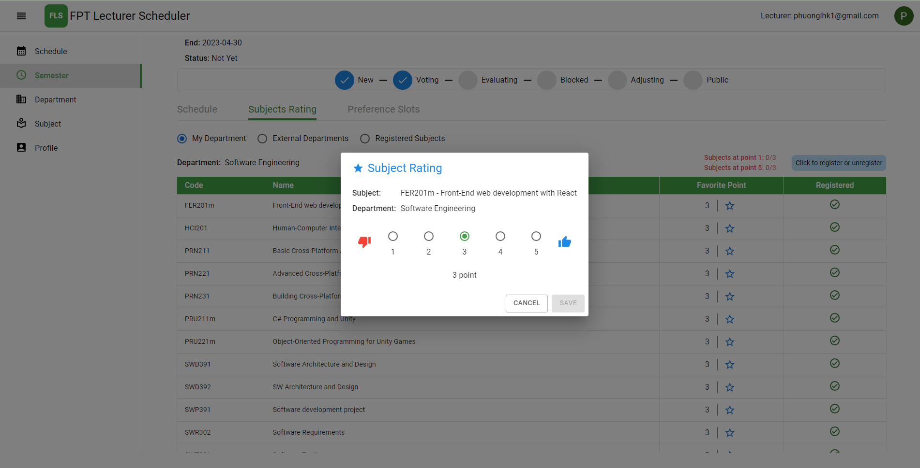
lecturer
Rate Favorite Subjects
Register Subjects
Request External Subjects
Prefer Slots

Slide 24
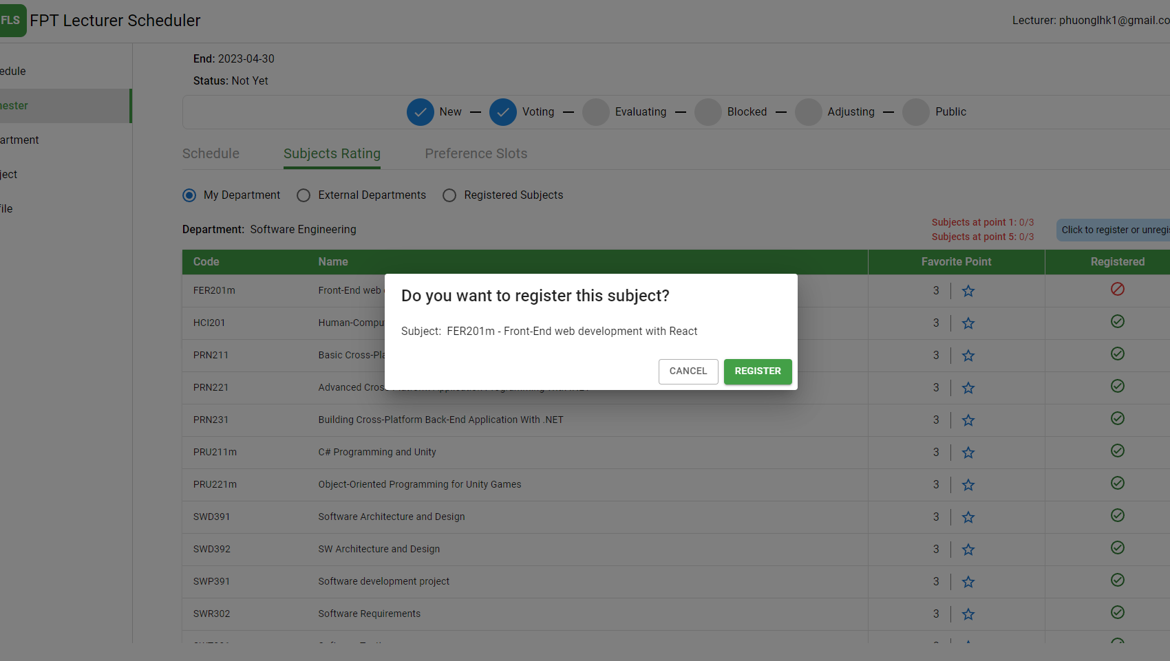
lecturer
Rate Favorite Subjects
Register Subjects
Request External Subjects
Prefer Slots

Slide 25
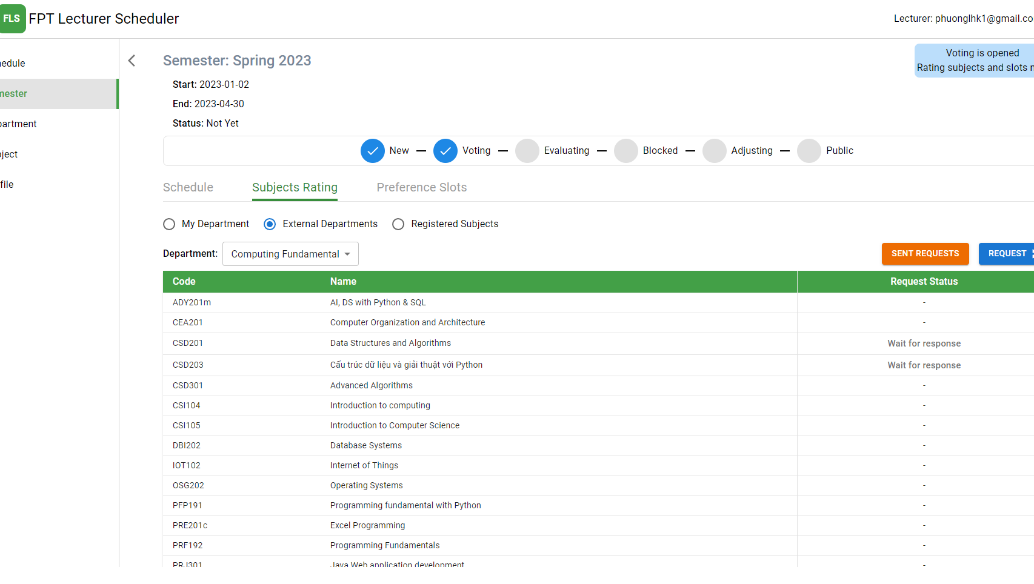
lecturer
Rate Favorite Subjects
Register Subjects
Request External Subjects
Prefer Slots

Slide 26
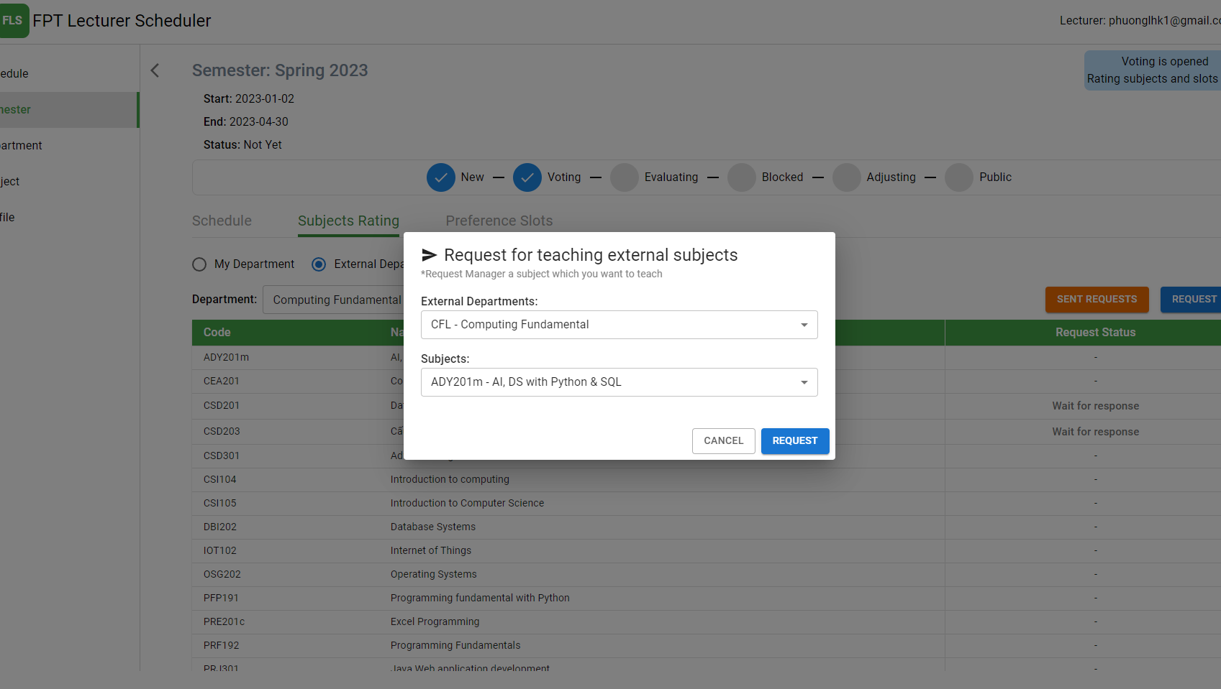
lecturer
Rate Favorite Subjects
Register Subjects
Request External Subjects
Prefer Slots

Slide 27
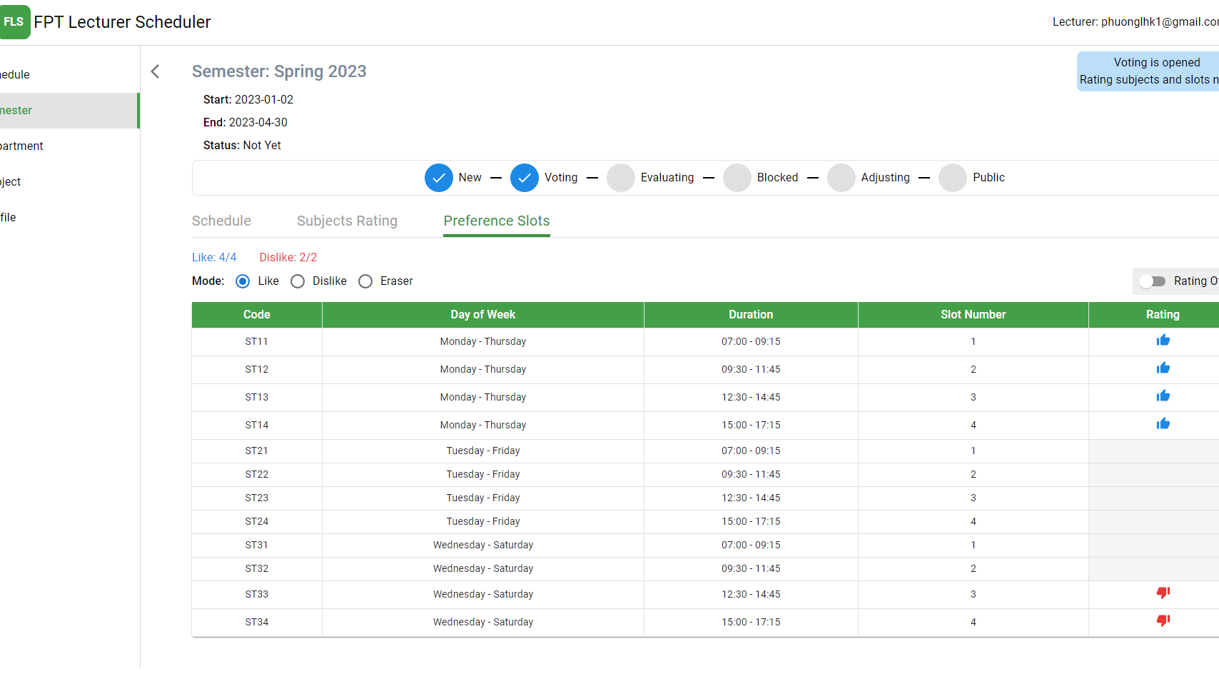
lecturer
Rate Favorite Subjects
Register Subjects
Request External Subjects
Prefer Slots

Slide 28
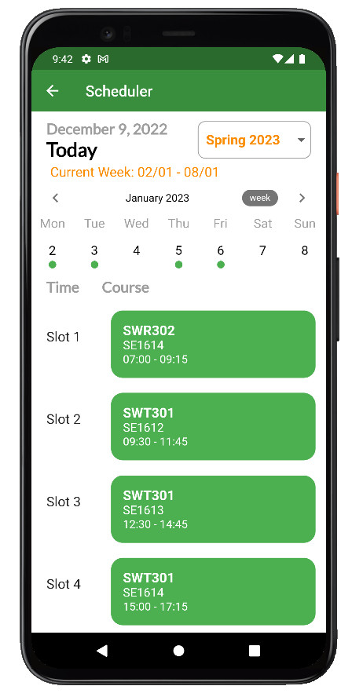
lecturer
View Schedule
View Request
View Registered Subjects

Slide 29
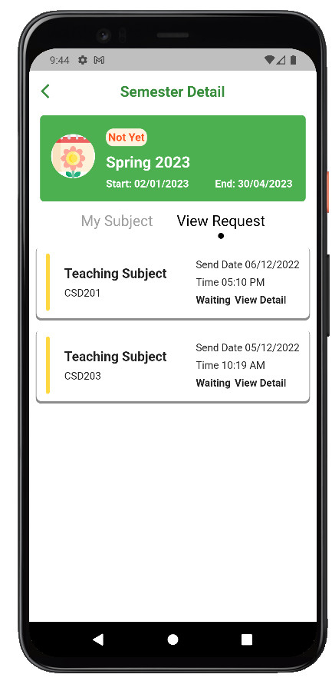
lecturer
View Schedule
View Request
View Registered Subjects

Slide 30
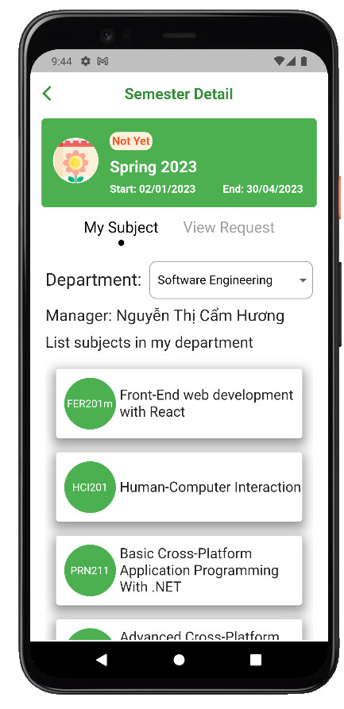
lecturer
View Schedule
View Request
View Registered Subjects

Slide 31

04
Demostration
Assumption
Demo
Solution & Algorithm

Slide 32





Assumption
CF
ITS
LAB
SE
46 Subjects
32 Lecturers
1 course: 20 slots
1 slot max: 60 courses

Slide 33
demo
web
winform
mobile

Slide 34
CORE FLOW & solution
Admin
Lecturer
Department Manager
Admin
Department Manager
Admin
New
Voting
Evaluating
Blocked
Adjusting
Public

Slide 35
Variables & Domains
List lecturers in semester
List courses in semester
List slot types in semester
Config of department manager in semester:
With lecturer and subjects
With lecturers and slots
With hard assign courses (pick a course with a slot and lecturer in schedule)
Group priority lecturer’s course
Config of lecturer in semester:
With subjects
With slots

Slide 36
Constraints
Hard Constraints:
A lecturer can only teach a course at time.
A course can only be taught by a lecturer.
Courses conflict cannot be taught at the same time.
Maximum number of courses in 1 week for lecturer are specified in each term.
The number of courses of a subject that a lecturer teaches that is specified in each term by department manager.
Department manager can specifically assign lecturer to specific slot with specific course.

Slide 37
Constraints
Soft Constraints:
Optimize the teacher's preference for the subject.
Optimize scheduling based on the rating score of the department manager for lecturers with the subject.
Optimize scheduling based on the department manager's priority for the course in the group course priority.
Optimize teacher preference with slots time.
Optimize the rest time between slots.

Slide 38
Lec
1
Lec
2
Lec
3
Lec
4
Lec
5
SE1001_SWT301
6
SE1002_SWT301
7
8
SE1001_
SWR302
5
SE1002
_SWR302
SE1003_LAB211
9
1
SE1004_LAB211
8
10
SE1003_CSI102
10
SE1004_CSI102
8
7
2
SE1005_PRM301
9
SE1006_PRM301
4
1
SE1005_DBW301
10
SE1006_DBW301

Slide 39
Lec
1
Lec
2
Lec
3
Lec
4
Lec
5
SE1001_SWT301
6,4
SE1002_SWT301
SE1001_
SWR302
7,5
5,7
SE1002
_SWR302
SE1003_LAB211
9,2
6,3
SE1004_LAB211
10
SE1003_CSI102
10
SE1004_CSI102
8,4
7
2
SE1005_PRM301
9,1
SE1006_PRM301
4,1
3,3
SE1005_DBW301
10
SE1006_DBW301
…….

Slide 40
SE1001_SWR302
SE1003_LAB211
SE1004_CSI102
ST11
8,9
9,2
9,1
ST12
9,1
9,4
9,3
ST13
ST14
ST21
8,8
9,2
9,1
ST22
9,1
9,4
9,3
ST23
ST24
ST31
ST32
ST33
5
5,1
4,9
ST34
5
5,1
4,9

Slide 41
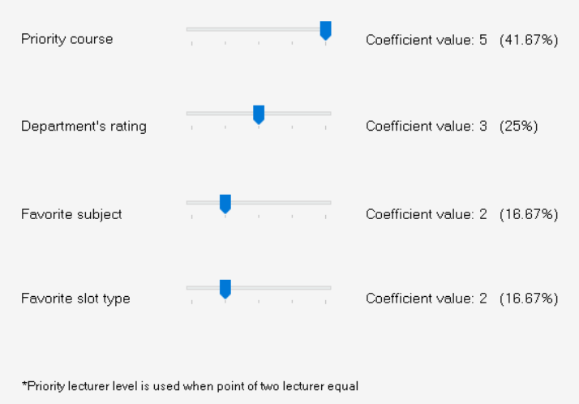
Priority course = CGL/4 * 41,67%
*CGL: Course Group Level
Department's rating = DGP /5 * 25%
*DGP: Department Manager Give Point
Favorite subject = FSP/5 * 16,67%
*FSP: Favorite Subject Point
Favorite slot type = SP * 16,67%
15:13
*SP: Slot Time Point
Sp = 1 If Lecture like a slot time
Sp = -1 If Lecture dislike a slot time
Sp = 0 If Neutral

Slide 42

05
Conclusion
Limitations & Futures

Slide 43





Limitations & Futures
Students
Rooms
Notes:
Áp dụng các kiến thức đã học và các công nghệ nhóm đã thực hiện được 2 mobile app và một web application để hỗ trợ kết nối khách du lịch với đối tác
Hệ thống hiện tại còn một số nhược điểm
Vấn đề về mạng bị ảnh hưởng với hệ thống
Khó khăn trong việc thiết kế cho thiết bị IOT Thứ 2 là thuật toán recommend đường đi cho khách hàng vẫn còn chưa được tối ưu và hiệu suất vẫn chưa được tốt tăng trải nghiệm người dùng
Luồng book một lần với nhiều khách hàng chưa tối ưu về hiệu suất
Ứng dụng mobile chỉ phát triển môi trường android

Slide 44
THANK YOU
FOR YOUR ATTENDANCE
FLS Team

